Slide 1
VX 420: Business Basics for Entrepreneurship
The Lean LaunchPad: Revenue Streams
Version 6/15/12

Slide 2
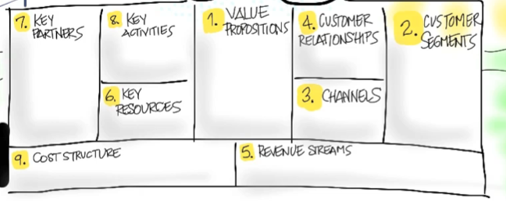
Revenue Streams
How do you Make Money?

Slide 3
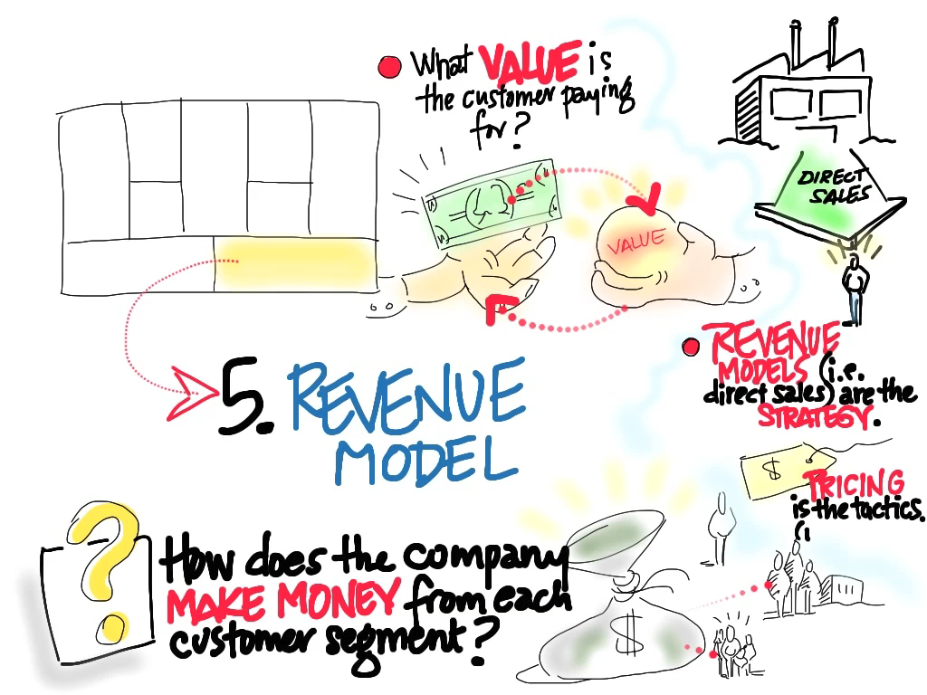
© 2012 Steve Blank

Slide 4
The Two Key Questions
What’s my revenue model?
Within the revenue model – how do I price the product?

Slide 5
Revenue Model =
the strategy the company uses to generate cash from each customer segment

Slide 6
Revenue Streams
How many will we sell?
Where/who is the money coming from?
How do we price the product?
Does this add up to a business worth doing?
Notes:
We must address these four questions to understand our revenue streams

Slide 7
How Many Will You Sell?
What’s the Market Size & estimate of Market Share?
How many can your channel sell?
How much will the channel cost?
How many customer activations?
Revenue? Churn/Attrition rate? customers/?
How much will it cost to acquire a customer?
How many units will they buy from each of these efforts?
Top down: 10% of a million-person market=100,000 customers Bottom up: 1,000 customers/month 1st year => 3,000/month 3rd year

Slide 8
Where is the money coming from?
Revenue Model Choices
Channel
Web
Physical
Direct Sales
Products
License
Subscription
Upsell/Next Sell
Ancillary Sales:
Referral revenue
Affiliate revenue
E-mail list rentals
Back-end offers
Direct Sales
Products
Subscription
Add-on services
Upsell/Next Sell
Referrals
Bits
Product
Direct Sales
Products
Service
Upsell/Next Sell
Referrals
Leasing
Physical

Slide 9
Key Revenue Model Questions
What are my customers paying for?
What capacity do my customers have to pay?
How will you package your product ?
How will you price the offerings?

Slide 10
Pricing Model =
the tactics you use to set the price in each customer segment

Slide 11
How to price the product?
Pricing Models - Physical
“Razor/razor blade” model
Subscription
Time/Hourly Billing
Leasing
Cost plus
Competitive pricing
Volume pricing
Value pricing
Portfolio pricing
Notes:
Cost-plus: rarely smart, but allows you to maximize revenues (not profit)
Competitive: if many other competitors in the space (match?, cost leader?, premium?) Value: consider the value delivered, not the cost.
Portfolio: if selling multiple products, find the best balance. Maybe a cost leader and profit from the more differentiated products
Razor: get lock-in with a low cost razor, make high margin on proprietary blades (ink jet)
Subscription: cheese of the month club
Leasing: lowers initial cost, lets them pay for it out of operating budget, not capital

Slide 12
Common approaches to pricing
Cost based
Cost + markup
Typically not a strategic way to price
Driven by internal economics and not customer insight
Value based
Based on buyer’s perception of value (e.g. time saved, new efficiency created, etc.)
Customers don’t necessarily feel that they want to pay this way

Slide 13
Additional components of pricing
Exclusive vs. non-exclusive
What do you price? What do you give away for free?
How does cost vary at different production levels?

Slide 14
Competition as an influence
Nature of Market
Pure competition
Oligopoly
Monopoly
How they will react?
What is their product?
What are their costs and prices?
“What pricing will make them feel the worst?”

Slide 15

Payment Flow
Draw the diagram
Put in numbers
Tennant
send monthly
water bill
water bill plus $2/month
$2/month
Property Owners
install meter
$9/month
(2yrs)
activities
$200 one time
Leasing company
payments

Slide 16
Single versus Multi-sided Markets

Slide 17
Single/Multi-side Markets
Single-sided markets care about revenues
Multi-sided markets may care about users first, revenues second
Often Web-based

Slide 18
“Users First” Companies
If you say your business is advertising based:
How do you get to 10M monthly users?
How do you become one of the top 5 websites visited?
How much do the “payers” actually pay?

Slide 19
“Revenue First” Companies
Time to doublings for monthly revenues
Key questions:
When will I get to $100k/month in revenues?
When will I get to $1M/month in revenues?
What assumptions about my business am I making when I reach these milestones?

Slide 20
Market Type and Revenue

Slide 21
Other Issues
Distribution channel affects revenue streams
Market type affects revenue streams
Demand curve affects revenue streams
Consider lifetime value
Notes:
Investors will always ask: what does it cost to acquire a customer? and what is the lifetime alue of each customer?

Slide 22
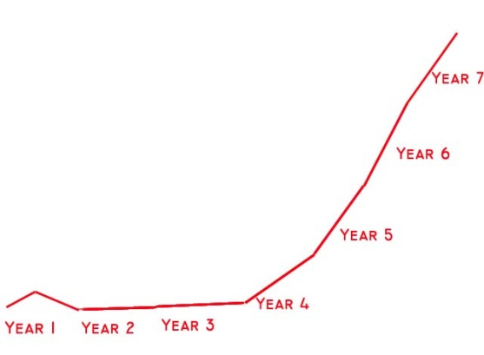
New Market Revenue Forecast
New Market Sales Curve

Slide 23
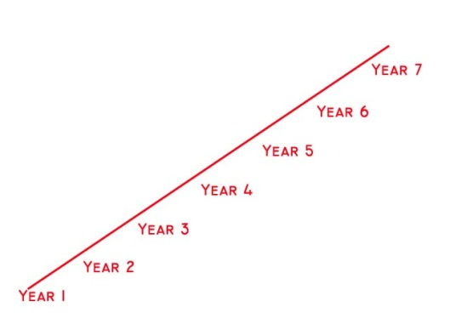
Existing Market Revenue Forecast
Existing Market

Slide 24
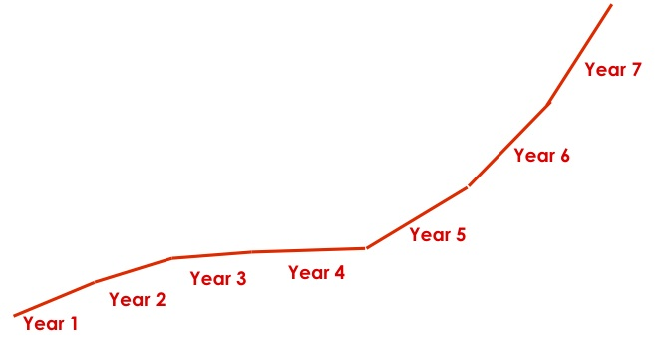
Resegmented Market Revenue Forecast

Slide 25
Common categories of Web/Mobile revenue models

Slide 26
“Direct” revenue models
Sales: Product, app, or service sales
Subscriptions: SAAS, games, monthly subscription
Freemium: use the product for free: upsell/conversion
Pay-per-use: revenue on a “per use” basis
Virtual goods: selling virtual goods
Advertising sales: unique and/or large audience

Slide 27
“Ancillary” revenue models
Referral revenue: pay for referring traffic/customers to other web or mobile sites or products.
Affiliate revenue: finder’s fees/commissions from other sites for directing customers to make purchases at the affiliated site
E-mail list rentals: rent your customer email lists to advertiser partners
Back-end offers: add-on sales items from other companies as part of their registration or purchase confirmation processes, or “sell” their existing traffic to a company that strives to monetize it and share the resulting revenu3

Slide 28

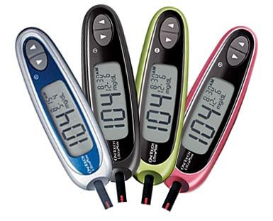

Asset Sale
Sale of ownership right to a physical product

Slide 29




Usage Fee
Usage of service. Fee is proportional to the usage of the service.

Slide 30


Subscription Fee
Fee for continuous access to a service

Slide 31


Renting
Fee for temporary access to a good or service

Slide 32


Licensing
Fee for use of some IP (including software)

Slide 33



Intermediation Fee
Often found in marketplaces of various types, a fee for bringing together two or more parties involved in a transaction

Slide 34




Advertising
Fee paid by brands and companies to get in front of potential customers

Slide 35
Revenue Model Summary

Slide 36

Example Analysis
Target market
USA market – 1.5 M patients
Europe – 2 M patients
Package
Reusable wrist watch
Disposable sensors / patch
Access to patients data
Product development
4 people in the beginning
$2 million
1.5 years to develop
Sales
Start in EU middle of year 3
Start in USA end of year 4
Personnel
Average salary $120 K
Load factor 1.5
Headcount from 4 to 174 in year 8
Financing
Series A – $3 M
Series B – $10 M
Price per package: $150
COGS
Operating Expenses
Profit
$60 per unit
$90 per unit

Slide 37
Does it add up?
Is revenue adequate to cover costs in the short term?
Are you confident revenue will grow materially if not dramatically over time?
Does profitability improve as the revenues get bigger?

Slide 38
Thought experiment
Time to doublings for monthly revenues
Key questions:
When will I get to $100k/month in revenues?
When will I get to $1M/month in revenues?
What assumptions about my business am I making when I reach these milestones?

Slide 39
Optics Design Company Revenue Model Example

Slide 40



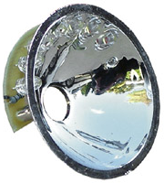

Revenue Model & Payment Flows
™
Customer:
LED company
LighTip™ Advanced Illumination Engineering
Engineering contract ($150-300/hour)
Light source
Quantity purchase of components for prototype & mass production .
Reflector
Desired
target
Key Partner:
Optical Manufacturer
Our deliverable
Prototype & High Volume Production (0.25%-8% commission)
Customer’s final product
5/23/2012

Slide 41
Optical Equipment Revenue Model Example

Slide 42
Academia Payment Flow
activity
Phi Optics
Component vendors
payment
QPI info & price
Buys QPI
device
funds grant/contract
request for equipment
Researcher
University Business Services
Grant Agencies
Industry Contracts
applies for grants/contracts

Slide 43
Bio-Pharma Payment Flow
activity
Phi Optics
Component vendors
payment
QPI specs
+ price
Includes equipment in the budget
Buys QPI
device
Researcher
Purchasing Dept.
CTO
VP for R&D
Justifies need for equipment

Slide 44
OEM Payment Flow
activity
Phi Optics
Equipment suppliers
payment
QPI specs + price
+ SOW
Allocates funds in the budget
Funds SOW
Pays royalties/sub-licensing/other recurring fees
Product Dev Engineers + Business Dev ($) + Legal Dept (royalties)
Accounting Dept.
CTO
VP for R&D
Justifies QPI integration in OEM system
Suggests co-development deal

Slide 45
Sensor Pricing Tactics Example

Slide 46
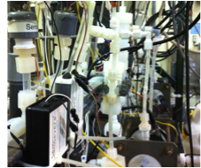
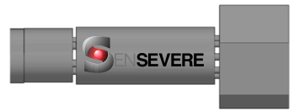

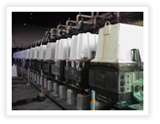
Understand Economics of Plant + Sensors
Industrial Plants
Understand Economics of Technology Supplier
Plant #1
Plant #2
Plant #3
Technology Supplier
Value pricing
Who does this?

Slide 47
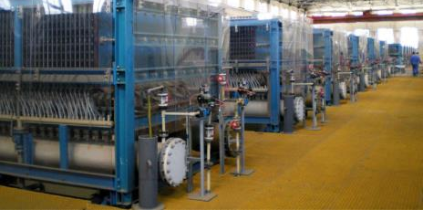
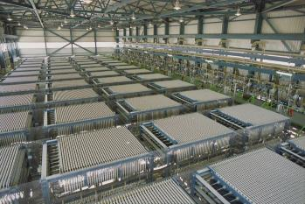

Diaphragm
Membrane
Operational conditions
Capital cost per incident
Downtime per incident
# of cells protected
Time between incidents
Number of cells, US and worldwide
$240/MT Cl2
Cost of damages + downtime per incident per year
Value per unit per year
Diaphragm | Membrane | Membrane Header
$2,500 | $270 | $10,600

Slide 48

Soft product launch projected for Q1-Q2 2012
General launch projected for Q4 2012
Diaphragm | Membrane | Membrane Header
$2,500 | $270 | $10,600
Year | Type | % | Revenue [/year]
1 | Innovators (US) | 2.5 | $271,500
Operating costs for 1st year projected to be $350,000
2 | Early Adopters | 16 | $15,040,000
3 | Early Majority | 50 | $47,000,000
4 | Late Majority | 84 | $78,960,000
 | Full Penetration | 100 | $94,000,000

Slide 49
Complex Sensor Networks Revenue Model Example

Slide 50

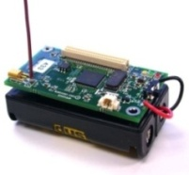







Revenue Model and Customer Acquisition
SET Sensor Node Product
Middleware and Reusable Software Subsystems
OEM HW components ($100 COGS)
SET’s price $400
Year 1:
(3 Customers)
1K nodes
Year 2:
(10 Customers)
5K nodes
Year 3:
(30 Customers)
30K nodes
Year 4:
(100 Customers)
200K nodes
Year 5:
(200 Customers)
400K nodes
$400K
$2M
$12M
$80M
$160M
First target
customers
Leverage our partners’ existing customers
Notes:
Progression: larger and larger sensor networks deployed

Slide 51
Medical Device Revenue Model Example

Slide 52
What we make
Device cost (one time)
~$2000
Dental
Optics
Dentist
Disposables
~$2.50 per patient

Slide 53
What the dentist normally makes
$250
Insurance
Membership
$250
Co-pay
Dentist
Patient
Equipment / Variable Costs
Note: Assumes 50/50 copay-insurance split
Notes:
----- Meeting Notes (3/6/12 10:38) -----
what the dentist makes for a perio procedure

Slide 54
What we’d add for the dentist
Device creates additional periodontal procedures
$250
Insurance
Device cost (one time)
Membership
~$2000
$250
Co-pay
Dental
Optics
Dentist
Patient
Disposables
~$2.50 per patient
Equipment / Variable Costs
Note: Assumes 50/50 copay-insurance split

Slide 55
Medical Device Pricing Example

Slide 56
MammOptics
Pricing Strategy
Equipment
Lease model
Per-use model
Consumable
Cost of the device
$50,000
$5,000
$5,000
$25,000
Service per year
$3,000
$10,000
0
0
Per-use fee
0
0
$50
0
Consumable
0
0
0
$20

Slide 57
MammOptics
Pricing Strategy
Approved by customers and investors
Equipment
Lease model
Per-use model
Consumable
Cost of the device
$50,000
$5,000
$5,000
$25,000
Service per year
$3,000
$10,000
0
0
Per-use fee
0
0
$50
0
Consumable
0
0
0
$20

Slide 58
Healthcare Software Revenue Model Example

Slide 59


Revenue Model
Healthcare Providers
Health Information Exchanges
Patient Data
Tailored Messaging
for + Patient Outcomes
Portal $$$
Patient Analytics $$$
Patient Data
Resources/Tools
Patient Profile
Health Insights
Patient

